Slide 1
Chapter 8:
Database Application Development
Modern Database Management
10th Edition
Jeffrey A. Hoffer, V. Ramesh,
Heikki Topi
© 2011 Pearson Education, Inc. Publishing as Prentice Hall

Slide 2
Objectives
Define terms
Explain three components of client/server systems: presentation, processing, and storage
Distinguish between two-tier and three-tier architectures
Describe how to connect to databases in 2-tier systems using VB.NET and Java
Describe key components and information flow in Web applications
Describe how to connect to databases in 3-tier applications using JSP, PHP, and ASP .NET
Explain the purpose of XML
See how XQuery can be used to query XML documents
Explain how XML fosters Web services and SOAs

Slide 3
Client/Server Systems
Networked computing model
Processes distributed between clients and servers
Client–Workstation (usually a PC) that requests and uses a service
Server–Computer (PC/mini/mainframe) that provides a service
For DBMS, server is a database server

Slide 4
Application Logic in C/S Systems
Presentation Logic
  Input–keyboard/mouse
  Output–monitor/printer
GUI Interface
Processing Logic
  I/O processing
  Business rules
  Data management
Procedures, functions,
programs
Storage Logic
  Data storage/retrieval
DBMS activities

Slide 5
Application Partitioning
Placing portions of the application code in different locations (client vs. server) after it is written
Advantages
  Improved performance
  Improved interoperability
  Balanced workloads

Slide 6
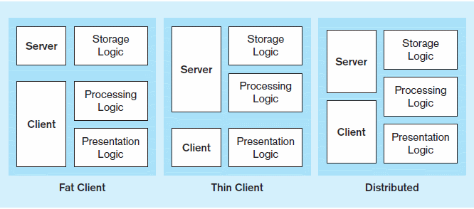
Figure 8-2 Common Logic Distributions
a) Two-tier client-server environments
Processing logic could be at client (fat client), server (thin client), or both (distributed environment)

Slide 7
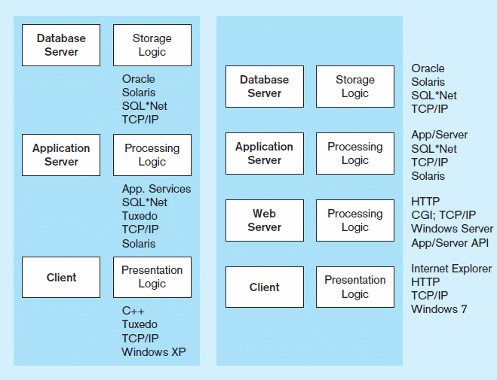
Figure 8-2 Common Logic Distributions
b) Three-tier and n-tier client-server environments
Processing logic will be at application server or Web server

Slide 8
Two-Tier Database Server Architectures
Client workstation is responsible for
  Presentation logic
  Data processing logic
  Business rules logic
Server performs all data storage, access, and processing
  Typically called a database server
  ➔ DBMS is only on server

Slide 9
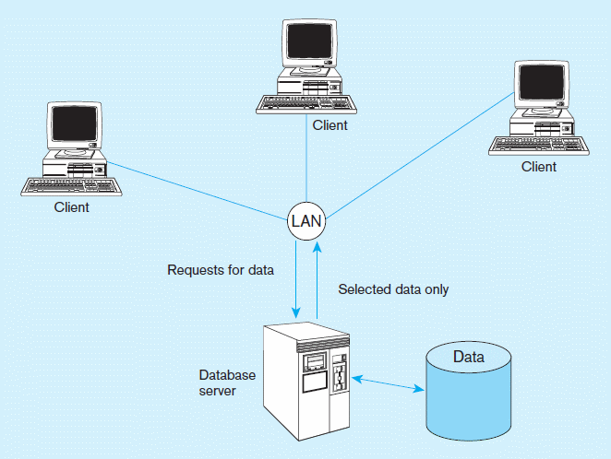
Figure 8-3 Database server architecture (two-tier architecture)
Front-end programs
Back-end functions

Slide 10
Characteristics of Two-Tier Client/Server Systems
Departmental in scope (few users)
Not mission-critical
Low transaction volumes
Common programming languages:
  Java, VB .NET, C#
Interface database via middleware, APIs

Slide 11
Middleware and APIs
Middleware – software that allows an application to interoperate with other software without requiring user to understand and code low-level operations
Application Program Interface (API) – routines that an application uses to direct the performance of procedures by the computer’s operating system
Common database APIs – ODBC, ADO .NET, JDBC

Slide 12
Steps for Using Databases via Middleware APIs
Identify and register a database driver.
Open a connection to a database.
Execute a query against the database.
Process the results of the query.
Repeat steps 3–4 as necessary.
Close the connection to the database.

Slide 13
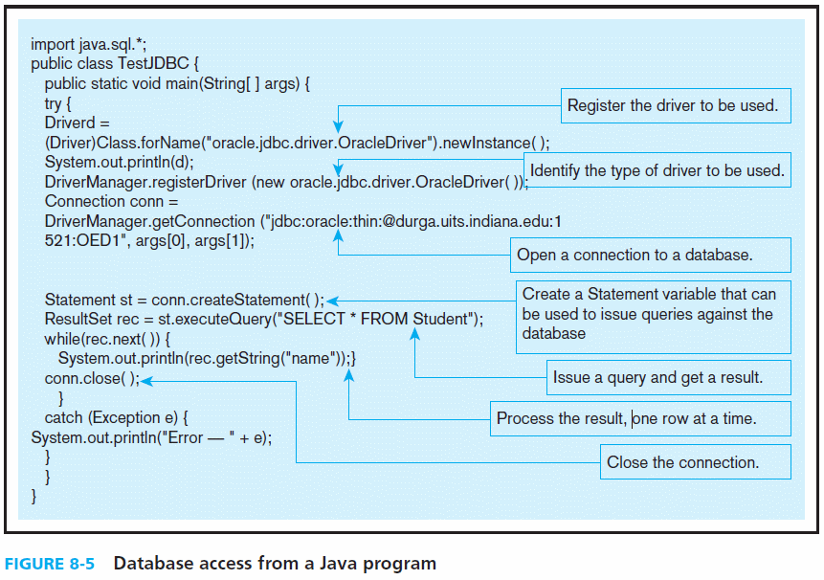

Slide 14
Three-Tier Architectures
Client
GUI interface
(I/O processing)
Browser
  Application server
Web Server
Business rules
  Database server
Data storage
DBMS
Thin Client
  PC just for user interface and a little application processing. Limited or no data storage (sometimes no hard drive)

Slide 15
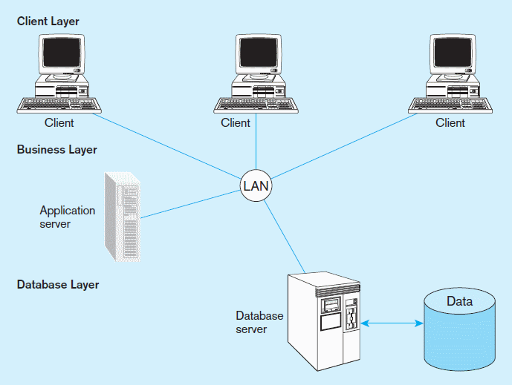
Figure 8-6a Generic three-tier architecture
Thin clients
Business rules on application
server
DBMS only on DB server

Slide 16
Thin Client
An application where the client (PC) accessing the application primarily provides the user interfaces and some application processing, usually with no or limited local data storage.
Most commonly, the thin client application is a Web browser and the 3-tier architecture involves a Web application.

Slide 17
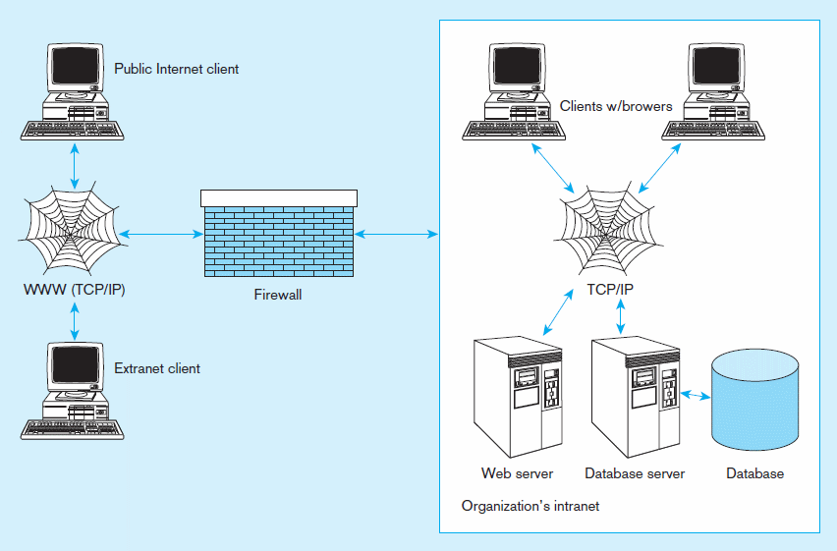
Figure 8-7 A database-enabled intranet/Internet environment

Slide 18
Web Application Components
Database server – hosts the DBMS
  e.g. Oracle, SQL Server, Informix, MS Access, MySql
Web server – receive and respond to browser requests using HTTP protocol
  e.g. Apache, Internet Information Services (IIS)
Application server – software building blocks for creating dynamic web sites
  e.g. MS ASP .NET framework, Java EE, ColdFusion, PHP
Web browser – client program that sends web requests and receives web pages
  e.g. Internet Explorer, Firefox, Safari, Google Chrome

Slide 19
Languages for Creating Web Pages
Hypertext Markup Language (HTML)
  Markup language specifically for Web pages
Standard Generalized Markup Language (SGML)
  Markup language standard
Extensible Markup Language (XML)
  Markup language allowing customized tags
XHTML
  XML-compliant extension of HTML
JavaScript/VBScript
  Scripting languages that enable interactivity in HTML documents
Cascading Style Sheets (CSS)
  Control appearance of Web elements in an HML document
XSL and XSLT
  XMS style sheet and transformation to HTML
Standards and Web conventions established by
World Wide Web Consortium (W3C)

Slide 20
Processing in 3-Tier Applications
Static page requests
  .htm or .html requests are handled by the Web server only
Dynamic page requests
  .jsp, .aspx, and .php requests are routed to the application server
  Server-side processing by JSP servlet, ASP .NET application, ColdFusion, or PHP
  Database access via JDBC, ADO .NET, or other database middleware

Slide 21
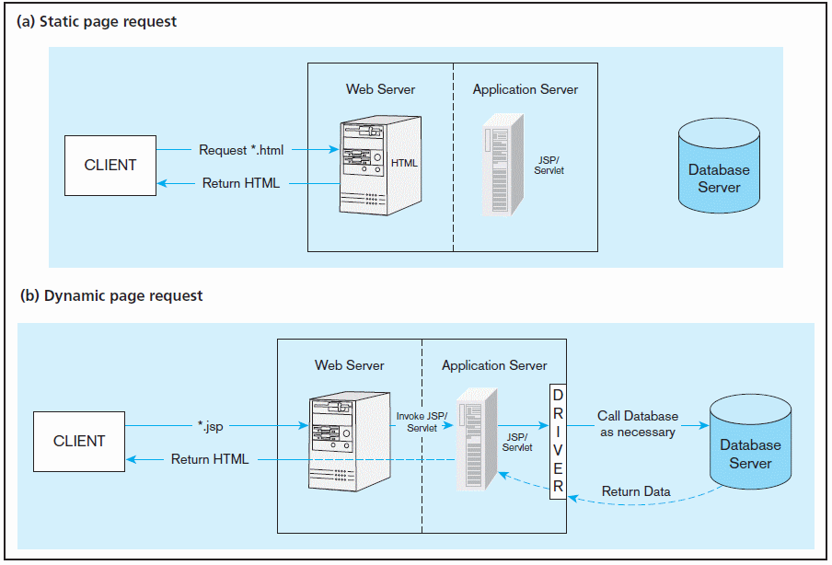
Figure 8-9 Information flow in a three-tier architecture
No server side processing, just a page return
Server side processing, including database access
…also *.aspx or *.php

Slide 22
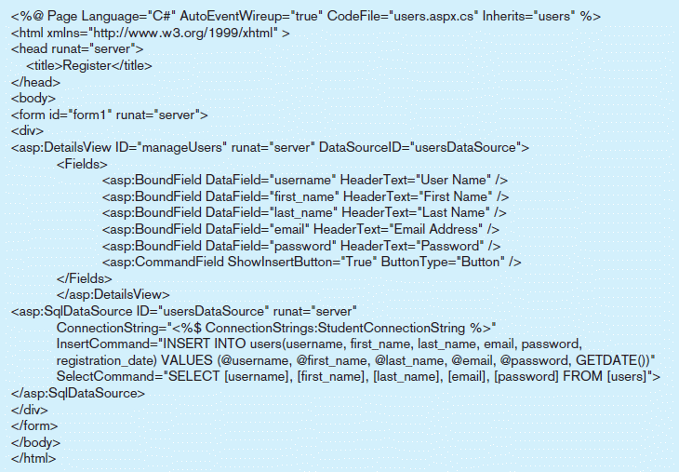
Figure 8-12 A registration page written in ASP .NET
a) Sample ASP .NET code for user registration

Slide 23
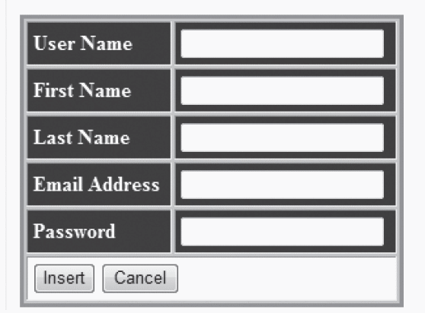
Figure 8-12 A registration page written in ASP .NET
b) Form for the ASP .NET application

Slide 24
Considerations in 3-Tier Applications
Stored procedures
  Code logic embedded in DBMS
  Improve performance, but proprietary
Transactions
  Involve many database updates
  Either all must succeed, or none should occur
Database connections
  Maintaining an open connection is resource-intensive
  Use of connection pooling

Slide 25
Benefits of Stored Procedures
Performance improves for compiled SQL statements
Reduced network traffic
Improved security
Improved data integrity
Thinner clients

Slide 26
Benefits of Three-Tier Architectures
Scalability
Technological flexibility
Long-term cost reduction
Better match of systems to business needs
Improved customer service
Competitive advantage
Reduced risk

Slide 27
Extensible Markup Language (XML)
A text-based markup language (like HTML)
  Uses elements, tags, attributes
  Includes document type declarations (DTDs), XML schemas, comments, and entity references
Revolutionizes the way data are exchanged over the Internet
Document Structure Declarations (DSD), XML Schema (XSD) and Relax NG replacing DTDs for validating XML document structure
XSD – language for defining XML databases, recommended by the W3C

Slide 28
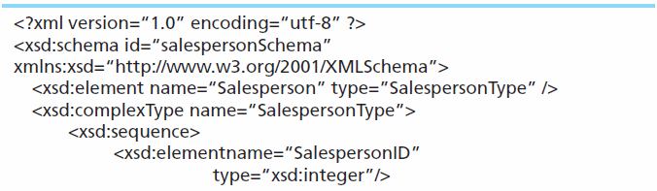
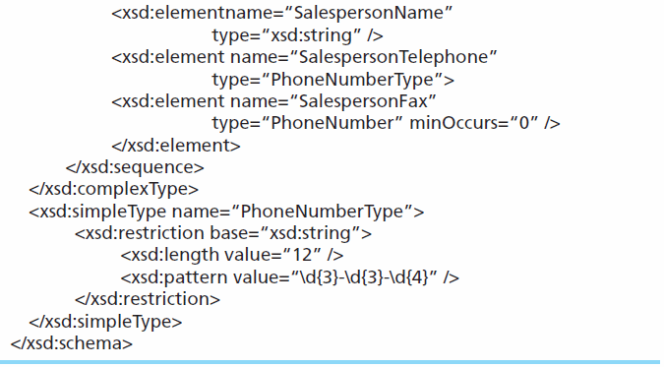
Sample XML Schema (XSD)
Schema is a record definition, analogous to the Create SQL statement, and therefore provides metadata

Slide 29
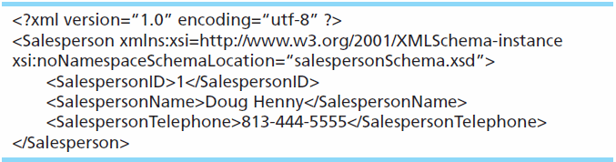
Sample XML Document Data
This XML data conforms to the XML schema of the previous slide, and involves elements and attributes defined in the schema.
This is analogous to a record in a database

Slide 30
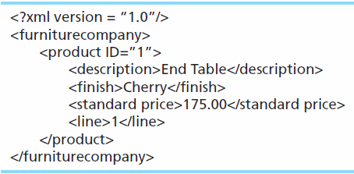
Another Sample XML Document

Slide 31
Storing XML Documents
Storing as files introduces the same file processing problems stated in Ch 1
Four common options:
  Store XML data in a relational database by shredding the XML document
  Store an entire XML document in a large field (BLOB or CLOB)
  Store the XML document using special XML columns
  Store the XML document using a native XML database (non-relational)

Slide 32
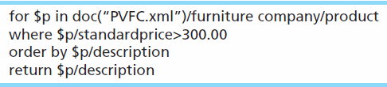
Retrieving XML Documents
XPath – One of a set of XML technologies supporting XQuery development, locating data in XML documents
XQuery – An XML transformation language that allows applications to query both relational databases and XML data
Sample XQuery expression:

Slide 33
Displaying XML Data
Extensible Stylesheet Language Transformation (XSLT) – A language used to transform complex XML documents and also used to create HTML pages from XML documents
XSLT can translate a single XML document into both standard HTML and WAP/WML for cell phones without the necessity for two different pages

Slide 34
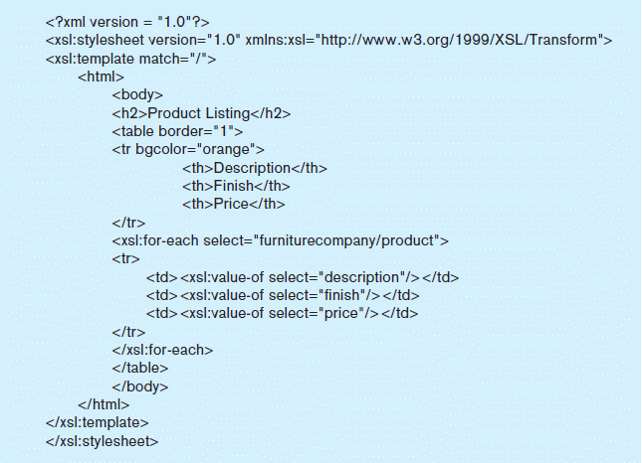
Figure 8-15b – XSLT Code

Slide 35
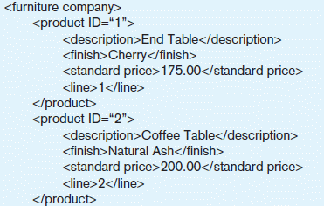
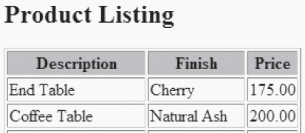
Extracted from Figures 8a and 8c
When applied to the above XML data, the XSLT code from Figure 8b produces the display on the right.

Slide 36
XML and Web Services
Web Services – a set of emerging XML-based standards that define protocols for automatic communication between software programs over the Web
Universal Description, Discovery, and Integration (UDDI) – standard for creating and distributing Web services
Web Services Description Language (WSDL) – XML-based grammar for describing a Web Service and specifying its public interface
Simple Object Access Protocol (SOAP) – XML-based communication protocol for sending messages between applications over the Internet

Slide 37
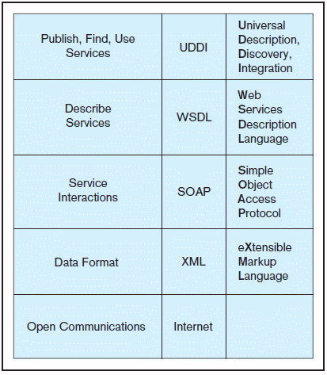
Figure 8-17 Web Services protocol stack

Slide 38
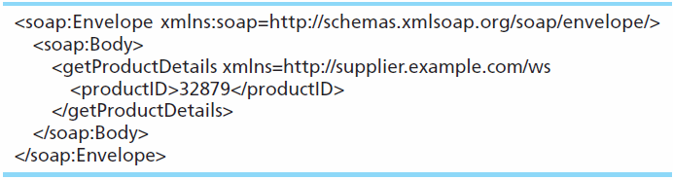
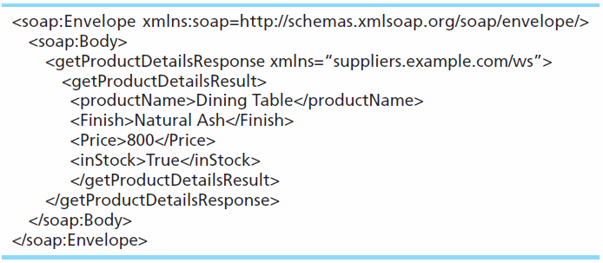
SOAP request sent from customer to supplier
SOAP response sent from supplier to customer

Slide 39
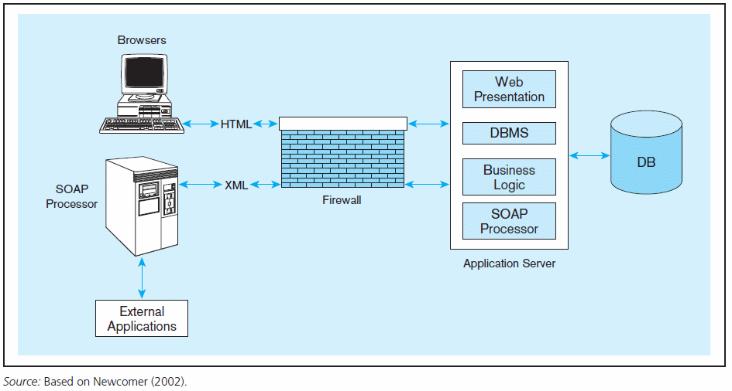
Figure 8-18 Web services deployment

Slide 40
Service Oriented Architecture (SOA)
A collection of services that communicate with each other in some manner, usually by passing data or coordinating a business activity
A new paradigm for IT application development, based mostly on Web services
Loosely coupled, highly interoperable components
Leads to flexibility and shorter development time

Slide 41

All rights reserved. No part of this publication may be reproduced, stored in a retrieval system, or transmitted, in any form or by any means, electronic, mechanical, photocopying, recording, or otherwise, without the prior written permission of the publisher. Printed in the United States of America.
Copyright © 2011 Pearson Education, Inc. Publishing as Prentice Hall

